Slide 1

Cross Platform Mobile and Web Apps Development
Day 5

Slide 2
Android Studio
Android Studio is the official Integrated Development Environment (IDE) for Android app development.
Android app development is done using the Java programming language, which you will learn in depth in the next course (WA140)

Slide 3
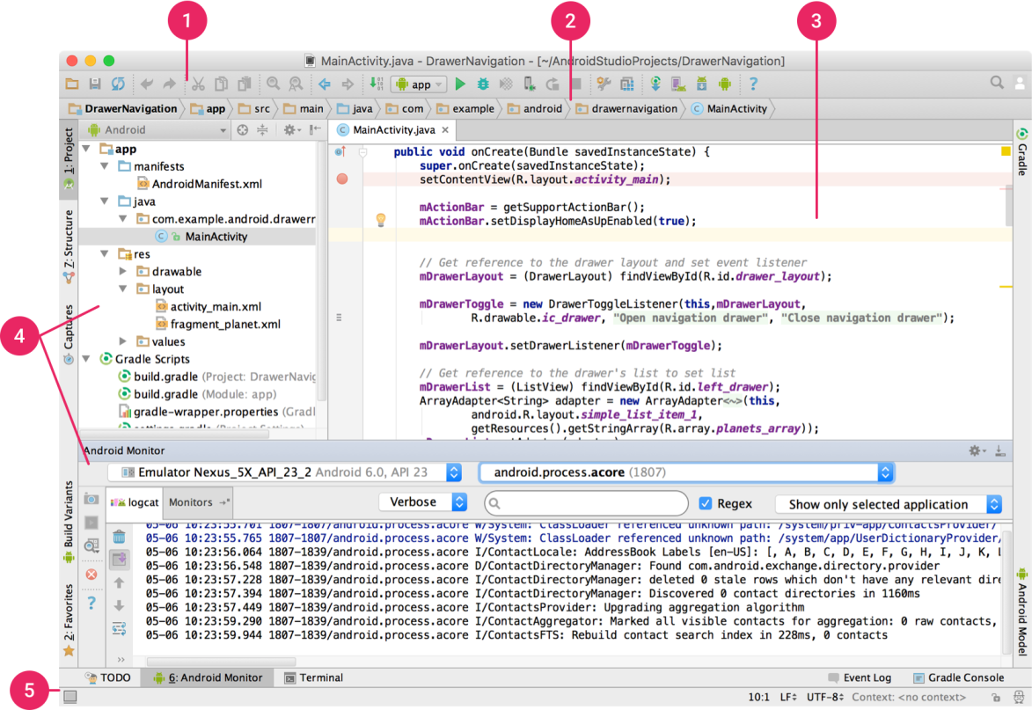
Android Studio Interface
The toolbar lets you carry out a wide range of actions, including running your app and launching Android tools.
The navigation bar helps you navigate through your project and open files for editing. It provides a more compact view of the structure visible in the Project tool window.
The editor window is where you create and modify code. Depending on the current file type, this window can change. For example, when viewing a layout file, the editor window displays the layout editor and offers the option to view the corresponding XML file.
Tool windows give you access to specific tasks like project management, search, version control, and more. You can expand them and collapse them.
The status bar displays the status of your project and the IDE itself, as well as any warnings or messages.
https://developer.android.com/studio/intro/index.html

Slide 4

Exercise 1
Download and install Android Studio from https://developer.android.com/studio/index.html
Create an Android app using the Android Studio tutorial at https://developer.android.com/training/basics/firstapp/creating-project.html
Create an Android Project
Run Your Application
Build a Simple User Interface
Start Another Activity

Slide 5
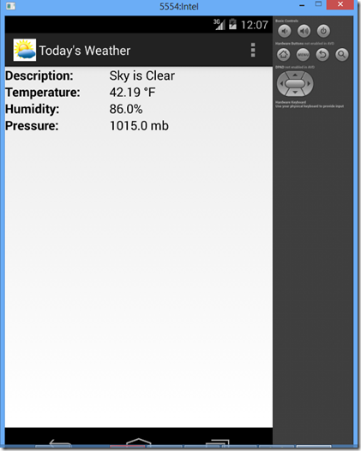
Exercise 2
Create a Weather App using the Android Studio tutorial at http://www.todroid.com/creating-a-weather-app-in-android-studio/
Create an Android Project
Build the Weather App
Choose the Emulator
Run the Weather App
Implement Layout and Fields
Add String Resources
Style the Labels
Add the Weather App Code
Call the Weather Service
Parse the JSON response
Allow Internet Access
Optional:
Debug the Weather App on Android Device
Generate a Signed Android Package Kit (APK) file
Deploy the Weather App to Android device

Slide 6
Learning Progress Assessment
Collect your WA130 projects (jQuery Mobile, Cordova and Android Studio) screenshots and code samples in a document for grading.
Describe what technical issues you faced and how you solved them.
Describe where you deviated from the exercise instructions and why.
Send the documentation to the instructor for grading.

